Slide 1
“Analysis of people’s sentiment towards the covid-19 vaccine”
Group Members:
Bindu Gutta
Adam Thorne
Naidan Zheng
Notes:
Prof. Suggestions:
Focus on clustering either instead of, or in addition to classification
Potentially use number of retweets as a weight

Slide 2
Abstract
On global crisis like the COVID-19 epidemic, social media platforms like Twitter are a great way to share information and opinions. We use natural language processing and sentiment analysis tools to uncover information on public awareness of COVID-19 vaccine.We scrape tweets based on various keywords connected to vaccinations and health and safety issues following vaccination. This project will help policymakers better assess public reaction and plan vaccination campaigns, as well as health and safety measures, in the midst of the ongoing global health crisis.

Slide 3
Data Scraping
Data will be gathered by scraping Twitter over various timeframes to get a wide variety of tweets related to the search term “COVID-19 Vaccine”, and various other related terms such as “COVID Vaccine” or “Moderna Vaccine”. Data gathered will include information such as the time of the tweet, the language of the tweet, the text within it, and potentially even the geodata of the tweet.
Data was originally planned to be collected using the Tweepy library in python.

Slide 4
snscrape instead of tweepy
Tweepy limits the amount of scraping at a time to 3200 individual tweets
Tweepy cannot get tweets in a range via datetime, only by date
Retweets in Tweepy are limited to only 140 characters before they are cut off
In response to this, we have transferred to using the snscrape library to gather our data
The benefits of this are that snscrape has no such limitations on how it gathers the data, and has shown to be much more efficient at doing so.
Columns of the dataframe include: url, date, content, user, lang, likeCount, retweetCount, and hashtags.
As we are doing a monthly analysis to detect change in people's sentiment, we have 6 datasets of 6 months march, april and may of 2020 and 2021.
In each dataset row size = 50000, column size = 31.
Collective(of 6 datasets) row count is 300000, column count = 31.

Slide 5
Pre-processing, ML Techniques
Pandas to understand the scraped data.
Pre-processing techniques like removing punctuation, html elements, removing stopwords, stemming or lemmatizing if needed, vectorizing data, feature engineering if required.
Libraries used : Pandas, NLTK VADER, bs4 , wordcloud.

Slide 6
Research Questions/Hypothesis
Is there a significant change in people's sentiment about vaccination?
Among the negative sentiment, what do people care most about?
Performing a time series forecasting
Notes:
Any changes of public sentiment?
Identification of negative sentiments on social media can help reduce the impact of misinformation

Slide 7
Literature Survey 1
While there is no state of the art missing with respect to using both text blob and vader, The biggest weak point we see with weka is it's inability to handle large data sets. If you have a large data set you will most likely run in to out of memory exception. You might need to do sampling to your data set or change the algorithm in to an incremental learning algorithm.
1.2 million tweets have collected across five weeks of April–May 2021 to draw conclusions about public sentiments towards the vaccination outlook when vaccinations become widely available to the population during the COVID-19 pandemic.
They deploy natural language processing and sentiment analysis techniques to reveal insights about COVID-19 vaccination awareness among the public.
Their results show that people have positive sentiments towards taking COVID-19 vaccines instead of some adverse effects
of some of the vaccines.
They also analyze people’s attitude towards the safety measures of COVID-19 after receiving the vaccines. Again, the positive sentiment is higher than that of negative in terms of maintaining safety measures against COVID-19 among the vaccinated population. We also project
that around 62.44% and 48% of the US population will get at least one dose of vaccine and be fully vaccinated, respectively, by the end of July 2021 according to our forecast model. For the collection of Twitter data and scraping tweets, they used Tweepy.
For natural language processing (pre-processing tweets before doing sentiment analysis), they used NLTK.
They used both TextBlob and VADER (because their data was unlabeled) to do the sentiment analysis.
For building their machine learning forecast model, they used WEKA 3.8.3 for the prediction of vaccinated US population.
“Sattar, N.S.; Arifuzzaman, S.
COVID-19 Vaccination Awareness and Aftermath: Public Sentiment Analysis on Twitter Data and Vaccinated Population Prediction in the USA.
Appl. Sci. 2021, 11, 6128.
https://doi.org/10.3390/app11136128”
Notes:
(Adam),To self, remember to focus on what are we doing differently, both in application and in methodology
This model focuses on many of the same topics as we do, but focused more on forecasting future vaccination rates, while ours would focus mor on public opinion

Slide 8
Literature Survey 2
The main disadvantage we see with using topic modelling are:
Fixed K (the number of topics is fixed and must be known ahead of time)
Uncorrelated topics (Dirichlet topic distribution cannot capture correlations)
Non-hierarchical (in data-limited regimes hierarchical models allow sharing of data)
Static (no evolution of topics over time)
Bag of words (assumes words are exchangeable, sentence structure is not modeled)
Public Perception of the COVID-19 Pandemic on Twitter: Sentiment Analysis and Topic Modeling Study
Goal: The goals of this study were to increase the awareness of the COVID-19 Pandemic in its early stages, and to discover any useful trends in public perception that can be discerned through english language twitter posts during this time.
Dataset: A dataset of over 100,000 English language tweets was collected from Twitter using the Twitter Streaming API, which was then stored in a MySQL database. The tweets that were collected were selected by meeting certain search terms such as ‘coronavirus’, ‘covid-19’ or ‘2019-ncovid’
Methodologies: The study used NLP, specifically the latent Dirichlet allocation algorithm for the purposes of topic modeling, as the main tools in their analysis.
Outcomes: Using topic modeling the study showed that twitter was a competent platform for increasing public awareness about a topic such as COVID-19.
Boon-Itt, S., &amp; Skunkan, Y. (2020). Public perception of the covid-19 pandemic on twitter: Sentiment analysis and topic modeling study. JMIR Public Health and Surveillance, 6(4). https://doi.org/10.2196/21978
Notes:
End goal may be similar to that achieved by Latent Dirichlet Allocation
Differences are that they focused on the early stages of the virus and public awareness

Slide 9
Text pre-processing
Removed HTML tags
Removed extra whitespaces
Convert accented characters to ASCII characters
Expand contractions
Remove special characters
Lowercase all texts
Remove numbers
Remove stopwords
Stemming,Lemmatization
Performed an initial tag cloud on 20,000 tweets for better key words to continue with the analysis.
Notes:
removed the urls, punctuation marks, and special characters in this step.

Slide 10
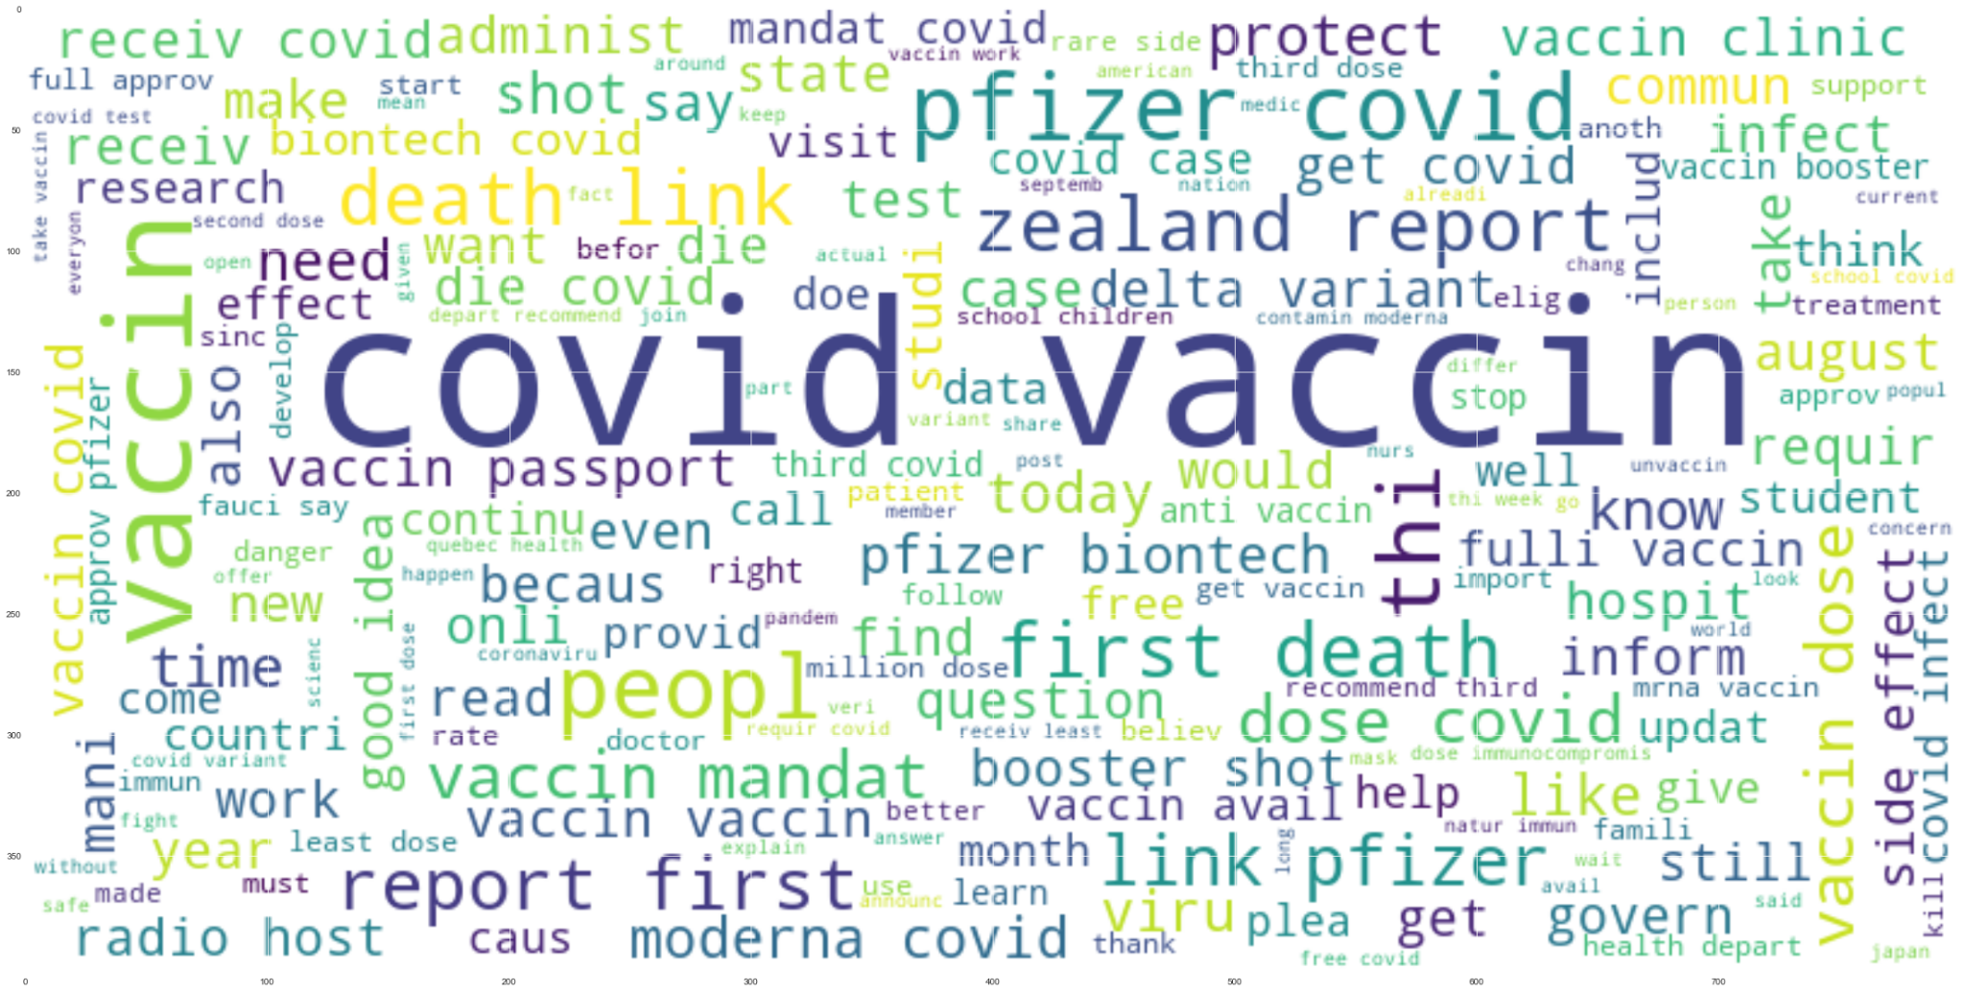

Slide 11
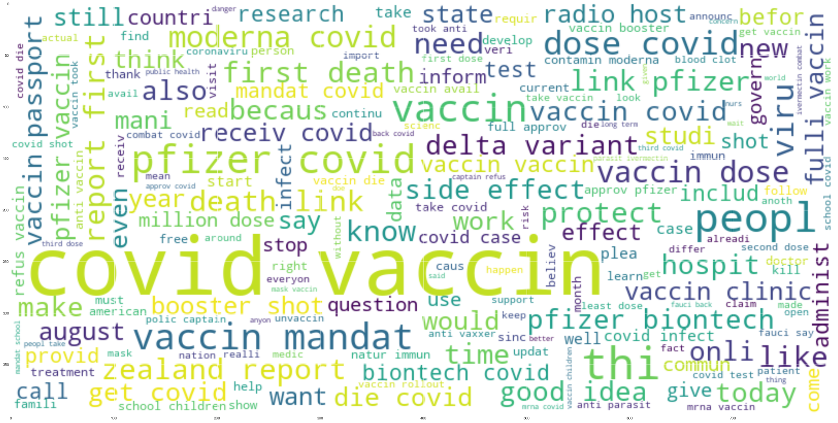

Slide 12
Implementation
Potential Methods
Time Series
Allow us to see the changes in attitude towards the vaccine both before and after distribution
Classification
Clustering
Allow commonalities within similar tweets to be easily seen
Notes:
SVM, KNN, Linear Regression, Random Forest,M5 model tree,Gaussian,Multiplayer Perception.

Slide 13
EDA
NLTK VADER :
Valence aware dictionary for sentiment reasoning
To do exploratory analysis of our dataset we used NLTK VADER Sentiment Intensity Analyzer.
Positive_Sentiment
Neutral_Sentiment
Negative_Sentiment
Compound_Sentiment
The sentiment score(range -1 to 1) of a sentence is calculated by summing up the sentiment scores of each VADER-dictionary-listed word in the sentence.
Amazon mechanical turk!
Vader sentiment scores are based on collective wisdom i.e wisdom of the crowd.
MTurk for ML development is human-in-the-loop (HITL), where human feedback is used to help validate and retrain your model
Notes:
We may want to look into rolling averages for Time Series

Slide 14

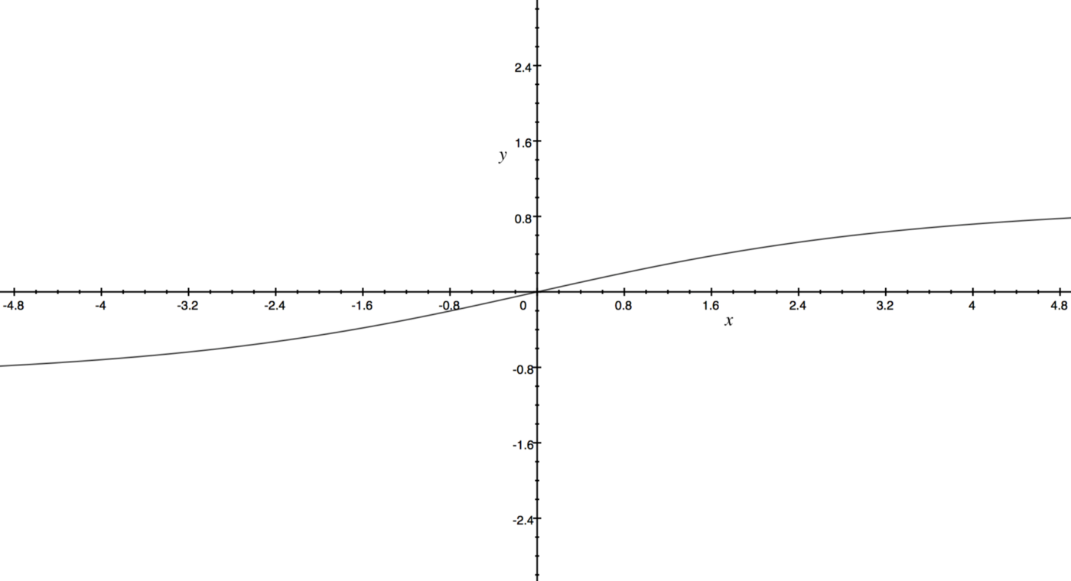
Hutto normalization equation:
Here x is the sum of the sentiment scores of the constituent words of the sentence and alpha is a normalization parameter.

Slide 15
References:
VADER: A Parsimonious Rule-based Model for Sentiment Analysis of Social Media Text
C.J. Hutto, Eric Gilbert
Yousefinaghani, S., Dara, R., Mubareka, S., Papadopoulos, A., & Sharif, S. (n.d.). An analysis of COVID-19 vaccine sentiments and opinions on Twitter. International Journal of Infectious Diseases. Retrieved September 22, 2021, from https://www.ijidonline.com/article/S1201-9712(21)00462-8/fulltext.
Version:0.9 StartHTML:0000000105 EndHTML:0000001144 StartFragment:0000000141 EndFragment:0000001104
Medhat, W.; Hassan, A.; Korashy, H. Sentiment analysis algorithms and applications: A survey. Ain Shams Eng. J. 2014, 5,
1093–1113.
Sattar, Naw S., and Shaikh Arifuzzaman. 2021. "COVID-19 Vaccination Awareness and Aftermath: Public Sentiment Analysis on Twitter Data and Vaccinated Population Prediction in the USA" Applied Sciences 11, no. 13: 6128. https://doi.org/10.3390/app11136128

